Slide 1
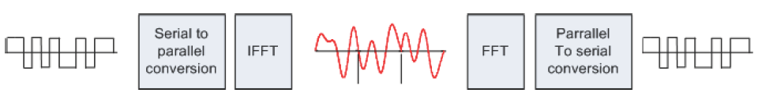
How OFDM works
What is working concept of OFDM?
What OFDM depends on?

Slide 2
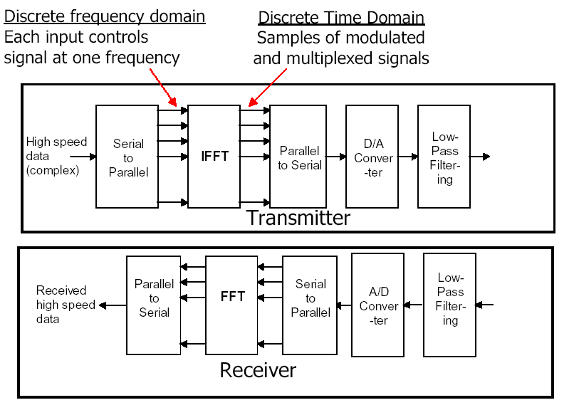
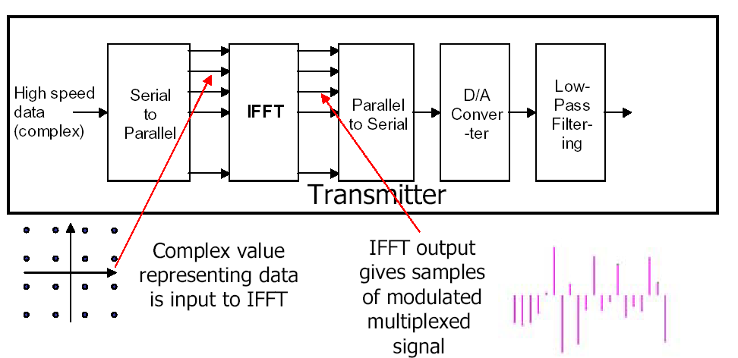
How OFDM works
What is benefit IFFT?
What is benefit FFT?

Slide 3
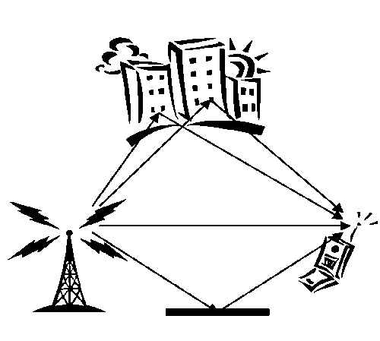
What is OFDM?
OFDM stands for Orthogonal Frequency Division Multiplexing. and is a modulation technique for transmitting large amounts of digital data over a radio wave.
what is multipath?

Slide 4
OFDM history
The concept of using parallel data transmission by means of frequency division multiplexing (FDM) was published in mid 60s
Some early development can be traced back in the 50s. A U.S. patent was filled and issued in January, 1970
In the 1980s, OFDM has been studied for high-speed modems .

Slide 5
Variations of OFDM:
Although that OFDM was a good solution for many problems but still there are some problems faced this techniques
Vector OFDM Broadband silicon vendor Broadcom and Cisco Systems developed VOFDM. VOFDM is most often used in fixed-wireless metropolitan area networks (MANs).(4)
Wideband OFDM
The OFDM Forum says Wi-LAN’s W-OFDM should be the standard version. Rather than using tightly packed orthogonal carriers,

Slide 6
Variations of OFDM:
F-OFDM Flarion created F-OFDM by incorporating fast-frequency-hopping spreadspectrum technology, which repeatedly switches frequencies during a radio transmission.
. Flarion designed F-OFDM, which is currently undergoing field testing, to deliver broadband services to cellular-phone and other mobile users.(4)
MIMO-OFDM Multiple-input, multiple-output OFDM was developed by Iospan Wireless. Basically, MIMO-OFDM uses OFDM to break up a signal and wirelessly transmit the pieces simultaneously via multiple antennas.

Slide 7
How OFDM differs from other multiplexing techniques?
*Orthogonality:
The “orthogonal” part of the OFDM name indicates that there is a precise mathematical relationship between the frequencies of the carriers in the system
Wireless The OFDM modulation scheme offers many advantages for broadband wireless transport. -It supports high data rates

Slide 8
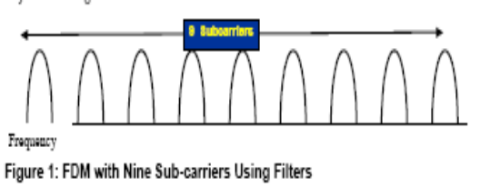
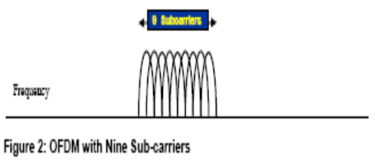
How OFDM differs from other multiplexing techniques?
The use of the IFFT in OFDM By the use of the Inverse Fast Fourier Transform (IFFT) algorithm. It can be better because it allows precise control

Slide 9
Where OFDM can be applied?
ADSL, SDSL and VDSL
Wi-Fi (IEEE 802.11a/g)
DAB systems
DVB
IEEE 802.16 or WiMAX Wireless MANs
FLASH-OFDM
Certain Ultra wideband (UWB)
Power line communication
MoCA home networking.

